Slide 1
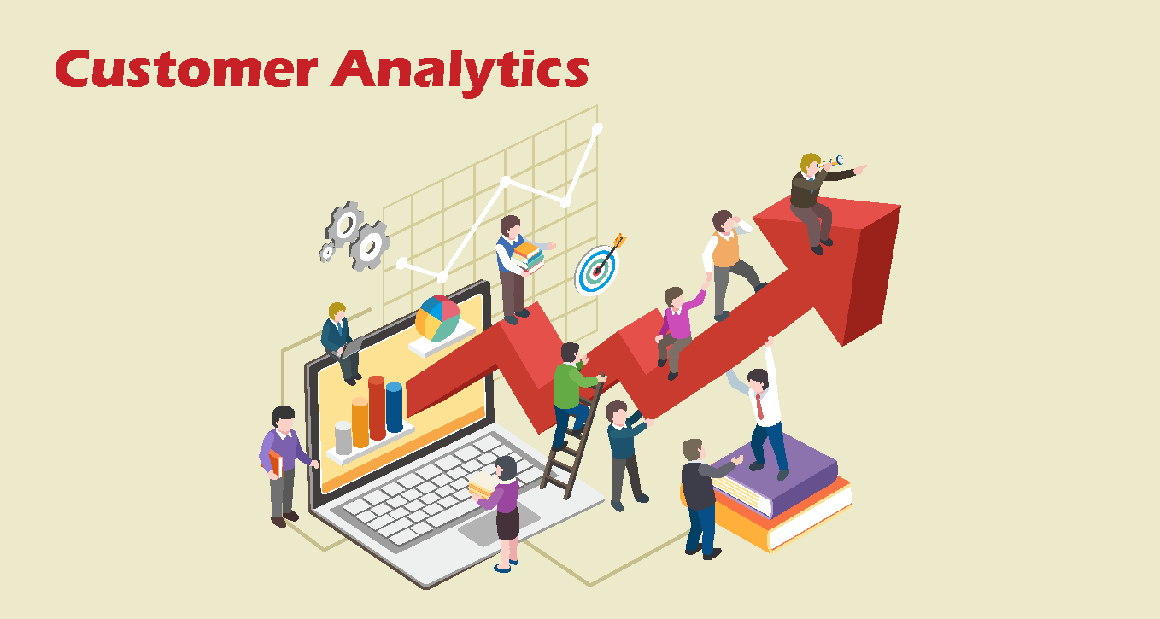
What is Customer Analytics
Customer analytics is the process of collecting, analyzing, and interpreting customer data to gain insights into customer behavior, preferences, and interactions. Businesses use these insights to understand their customers better, predict future behavior, and improve decision-making to enhance customer satisfaction, increase retention, and drive growth.

Slide 2
The Four Stages of Data Analytics
1
Descriptive Analytics: What happened?
2
Diagnostic Analytics: Why did it happen?
3
Predictive Analytics: What might happen in the future?
4
Prescriptive Analytics: What should we do about it?
Descriptive
Diagnostic
Predictive
Prescriptive

Slide 3
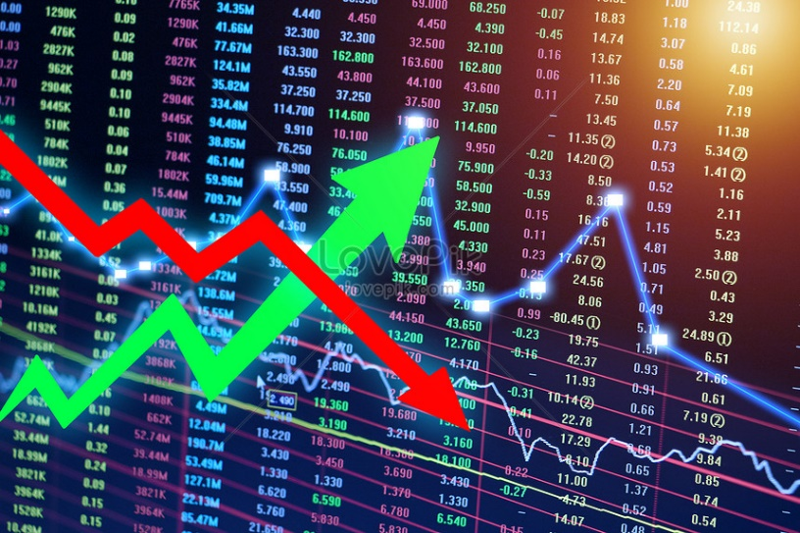
Descriptive Analytics
Descriptive
Diagnostic
Predictive
Prescriptive
Examination of data to answer "What happened?"
Summarizing raw data with dashboards, graphs, and tables.
Examples: Football match scorecard, stock market trends.
Customer Analytics Example: Dashboard with Customer metrics (Customer churn Rate, Customer Lifetime value).

Slide 4
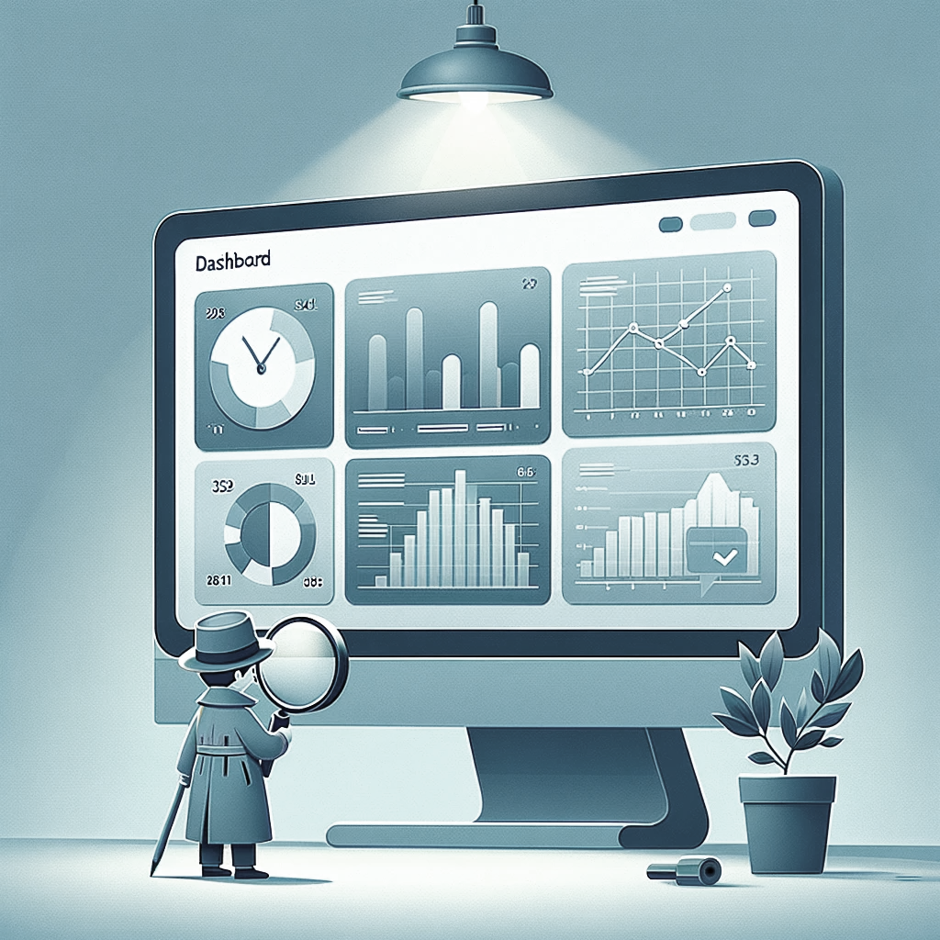
Diagnostic Analytics
Descriptive
Diagnostic
Predictive
Prescriptive
Answering "Why did it happen?"
Uncovering root causes and relationships.
Importance in understanding variables influencing outcomes.
Example: Analyzing the reasons behind stock market trends.

Slide 5
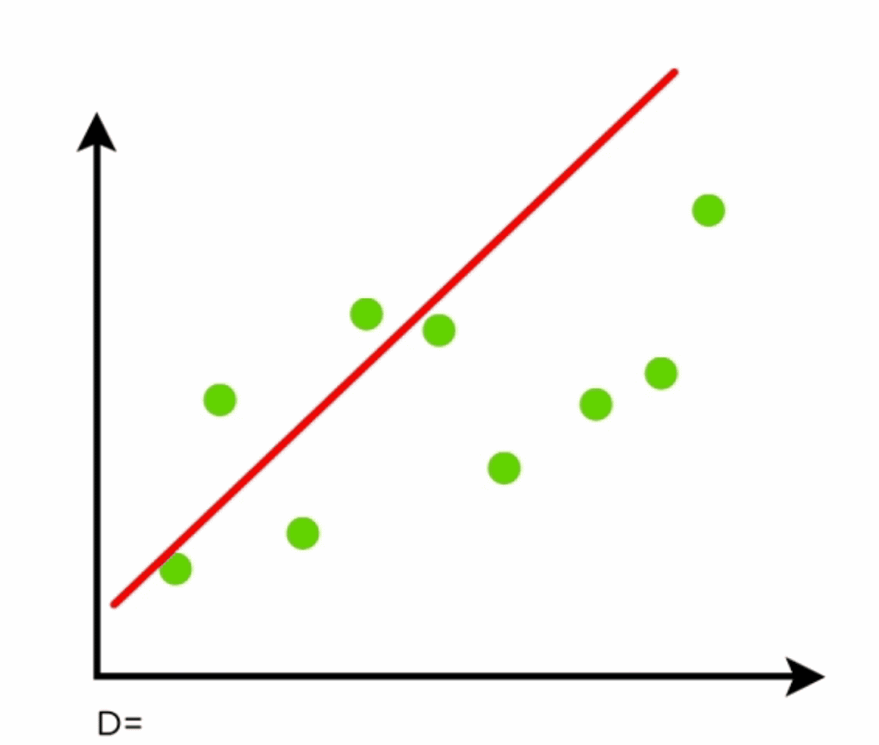
Predictive Analytics
Descriptive
Diagnostic
Predictive
Prescriptive
Using historical data and machine learning to forecast future outcomes.
Applications: Predicting customer churn, employee attrition, sales forecasts.
Customer Analytics Example: Predicting customer satisfaction for better sales.

Slide 6
Predictive Analytics
Descriptive
Diagnostic
Predictive
Prescriptive
Advanced tools: Python, R, SAS, Excel add-ons.
Application: Time series forecasting, regression models, machine learning
Example: Customer churn Prediction, Customer segmentation, CLV.

Slide 7

Prescriptive Analytics
Descriptive
Diagnostic
Predictive
Prescriptive
Suggesting actions based on predictions.
Using machine learning, business rules, and algorithms.
Providing recommendations for decision-making.
Example: Advising on stock purchases.

Slide 8
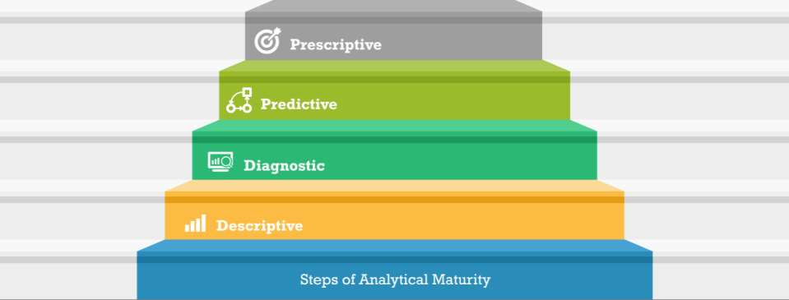
Pyramid of Data analytics
Approach to data
Mode
Benefits
Data products, data validated actions, increased success rate of strategic initiatives
What should I do to achieve my goal?
Proactive Action
Support for strategic initiatives, forward looking decision making
What is likely to happen?
Proactive Decisions
Proactive Consumption
Significant improvements from status quo, data backed management
Why did it happen?
What happened ?
Marginal business benefits, process gap identification
Active

Slide 9
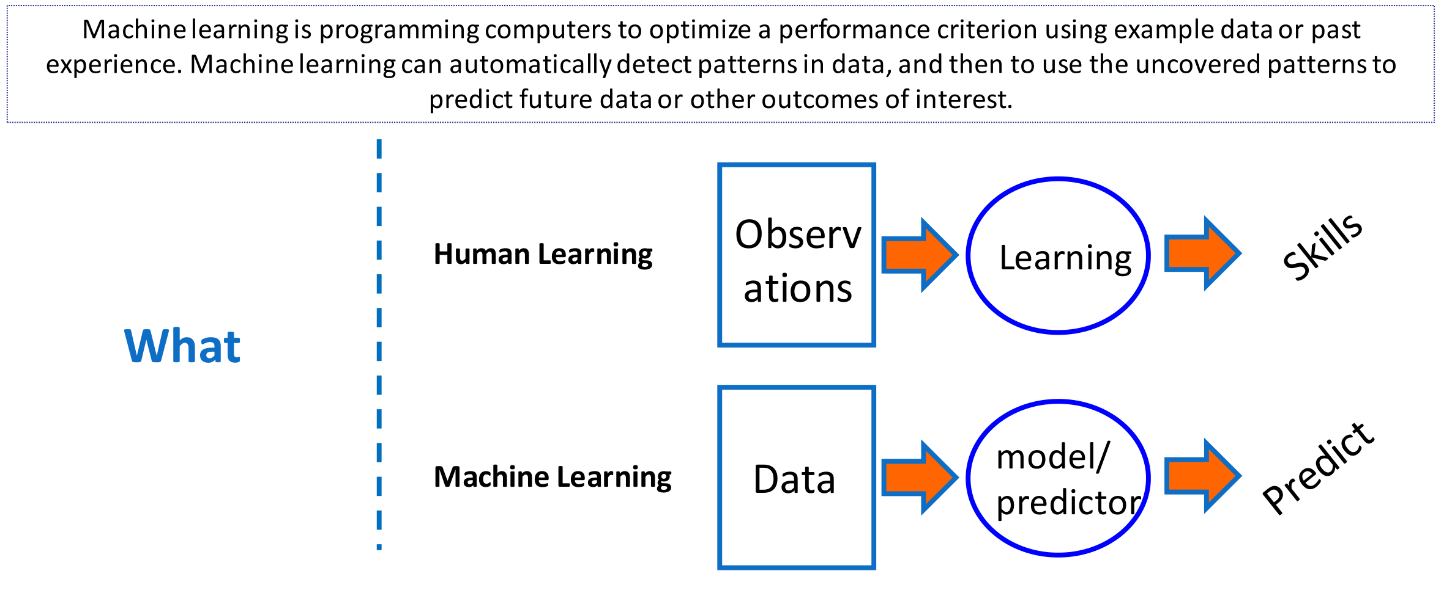
Machine Learning

Slide 10
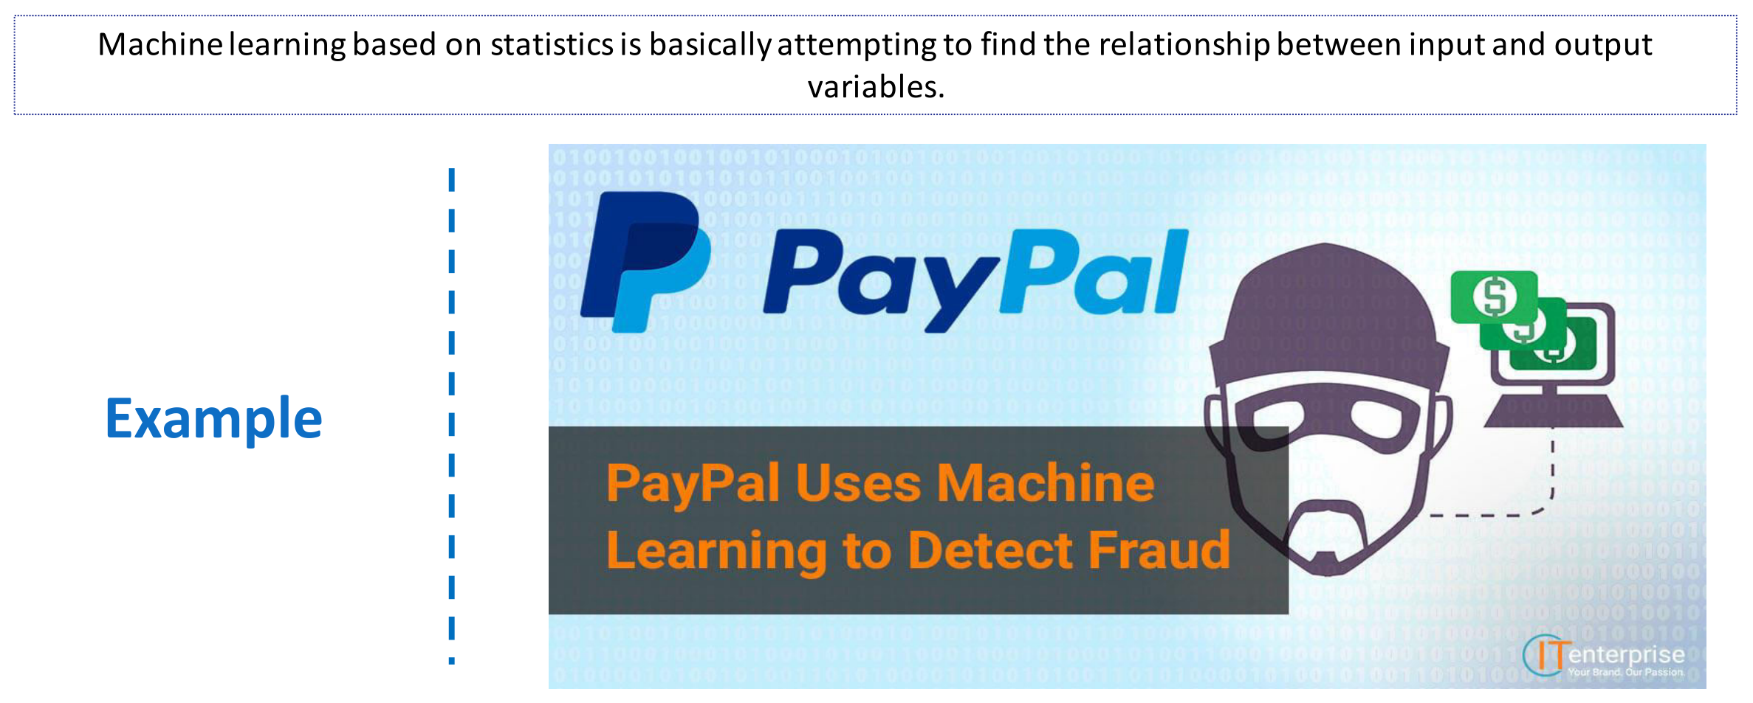
Machine Learning

Slide 11
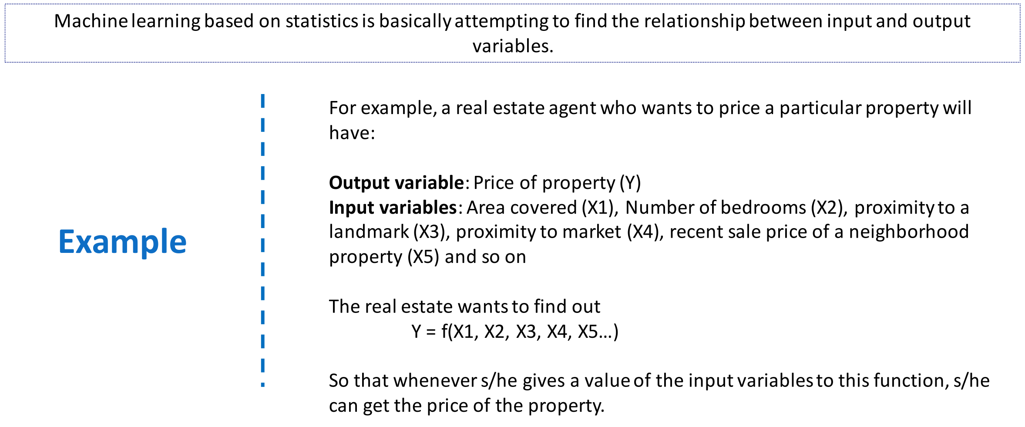
Machine Learning

Slide 12
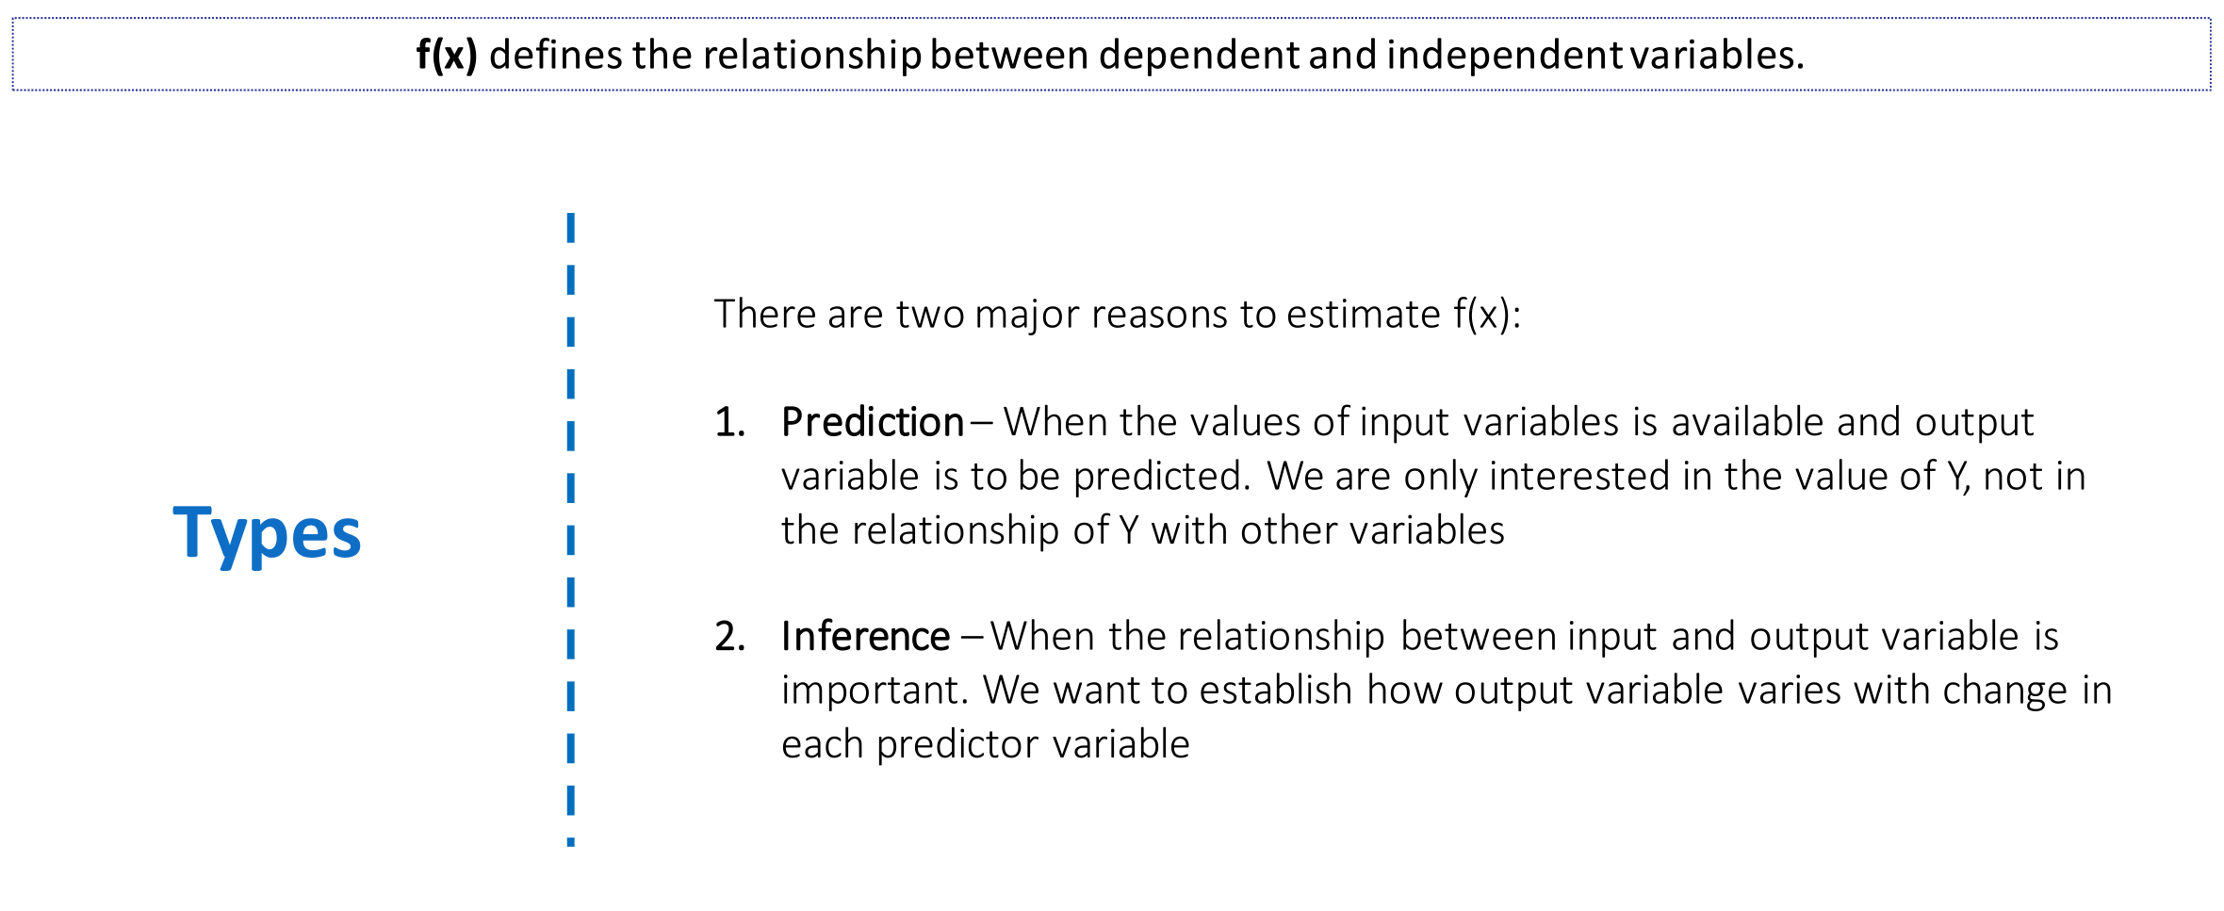
Machine Learning

Slide 13

Regression
Regression
Classification
Forecasting
Clustering
Regression is all about predicting a continuous output variable based on one or more input variables
Predict the price of a used car from factors like the car's age, mileage, and brand

Slide 14
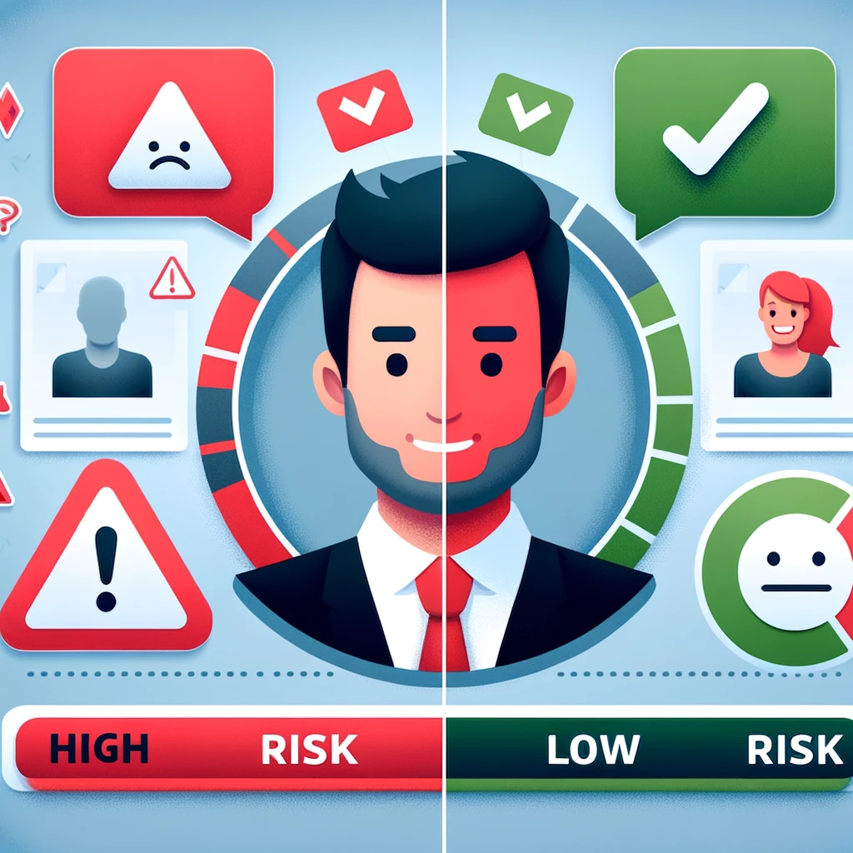
Classification
Regression
Classification
Forecasting
Clustering
Classification is used when we want to predict a categorical output
A bank might want to determine whether a loan applicant is high-risk or low-risk

Slide 15
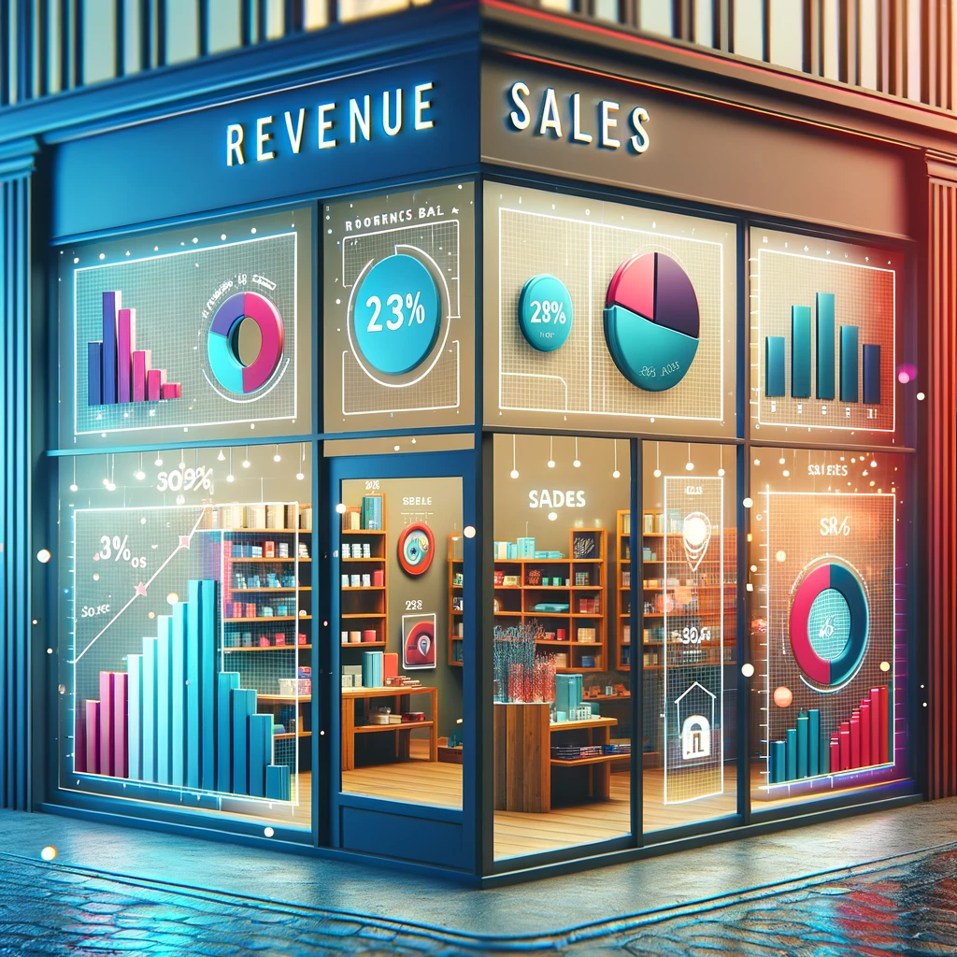
Forecasting
Regression
Classification
Forecasting
Clustering
Forecasting is predicting future events based on historical data
A retail store might forecast future sales

Slide 16

Clustering
Regression
Classification
Forecasting
Clustering
Clustering is a technique used to group similar data points together based on their characteristics
For instance, a marketing team might want to segment customers into different groups based on purchasing behavior, demographics, and preferences

Slide 17
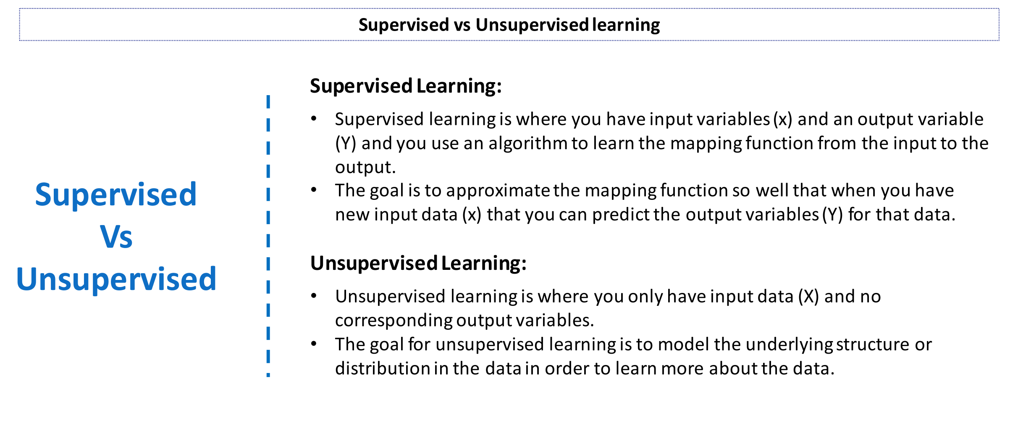
Machine Learning

Slide 18
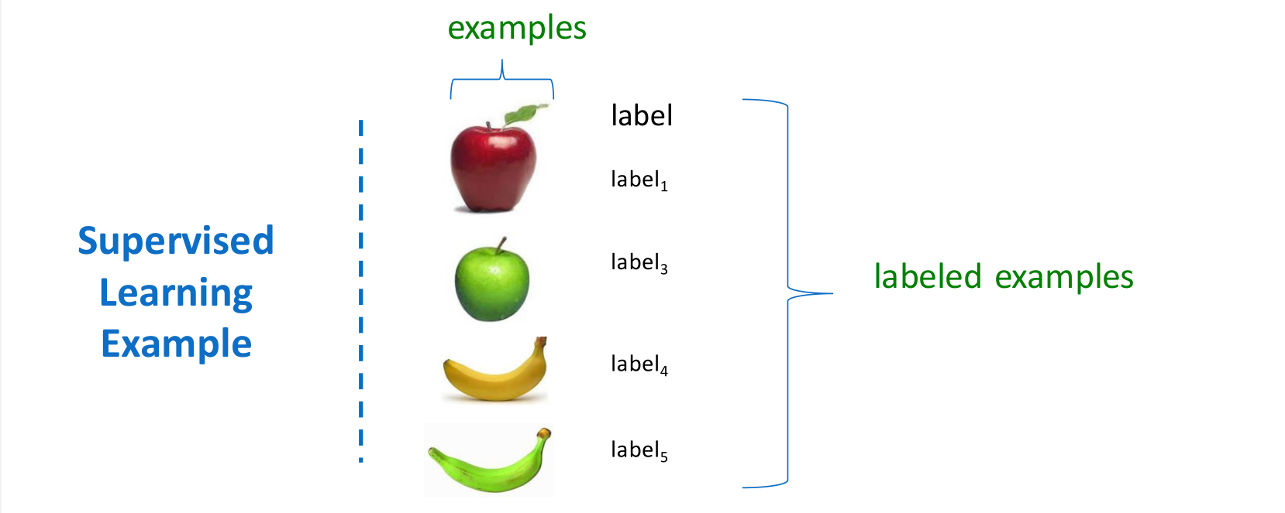
Machine Learning

Slide 19
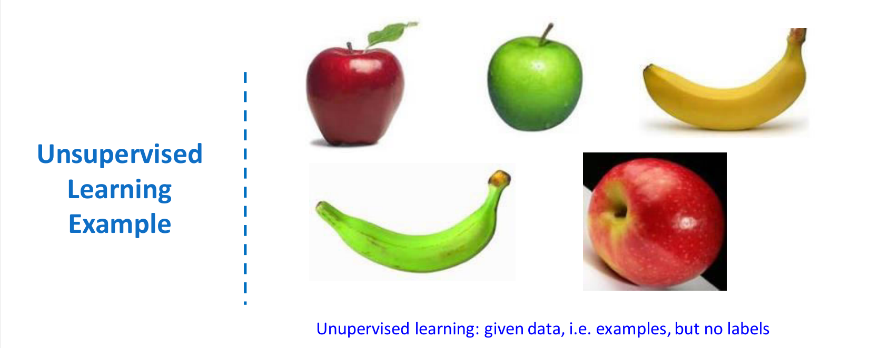
Machine Learning

Slide 20
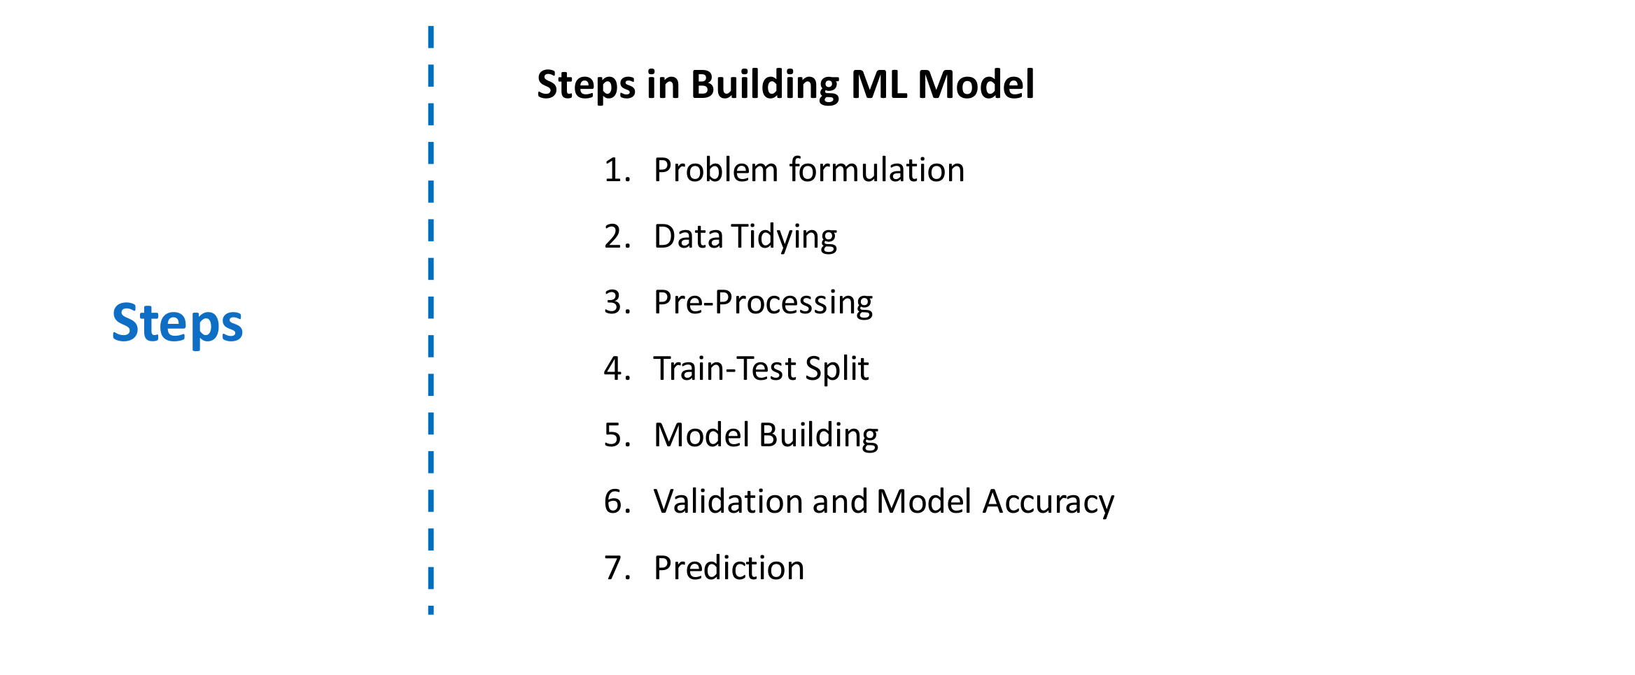
Machine Learning Model

Slide 21
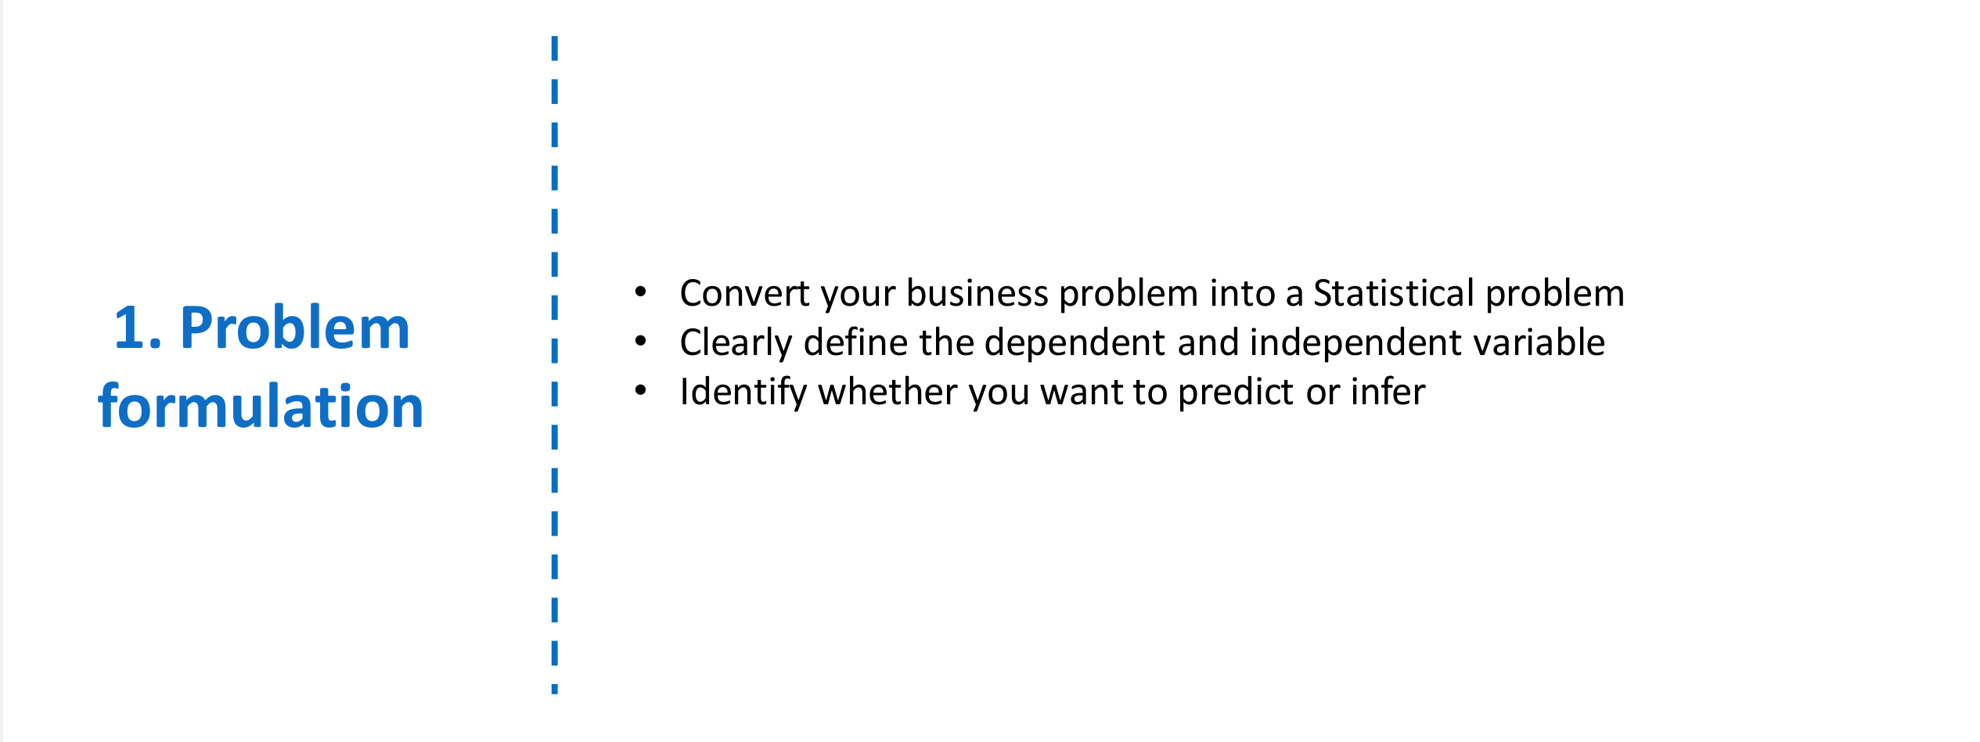
Machine Learning Model

Slide 22
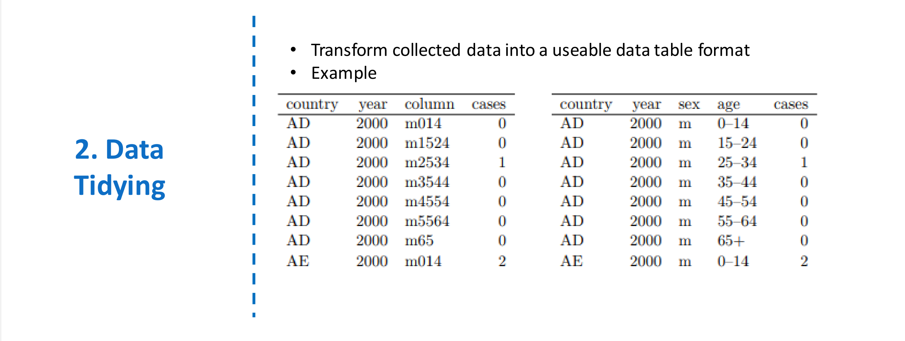
Machine Learning Model

Slide 23
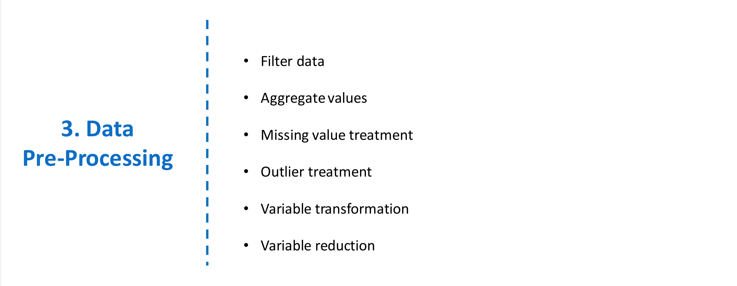
Machine Learning Model

Slide 24
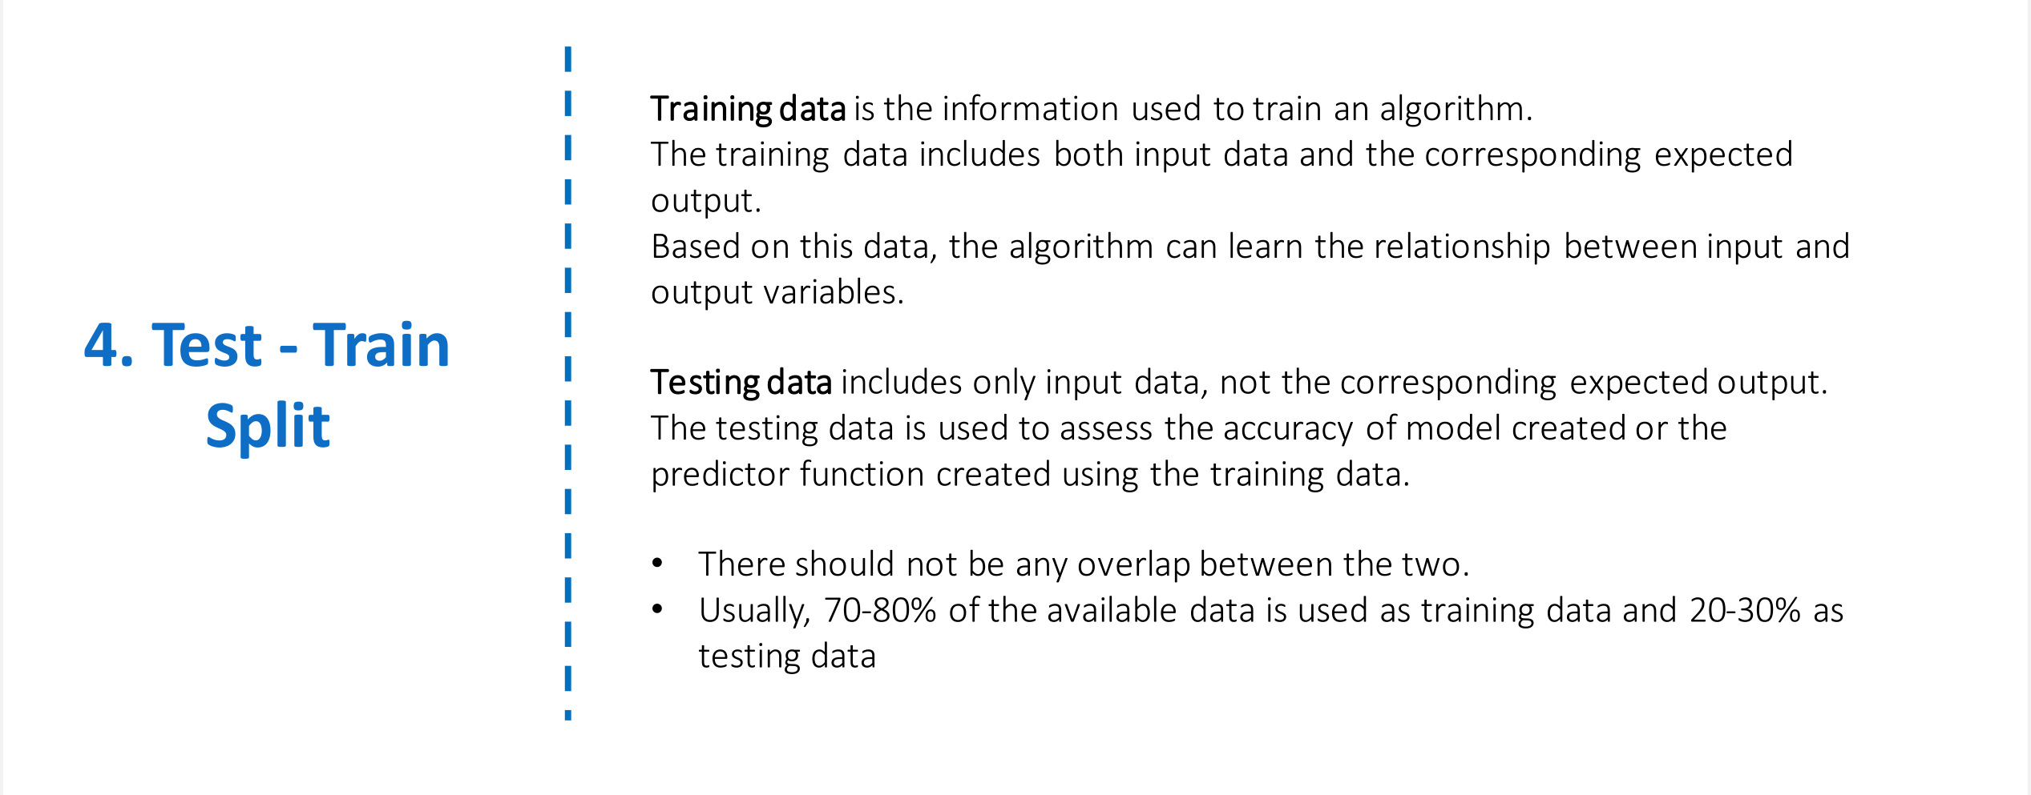
Machine Learning Model

Slide 25
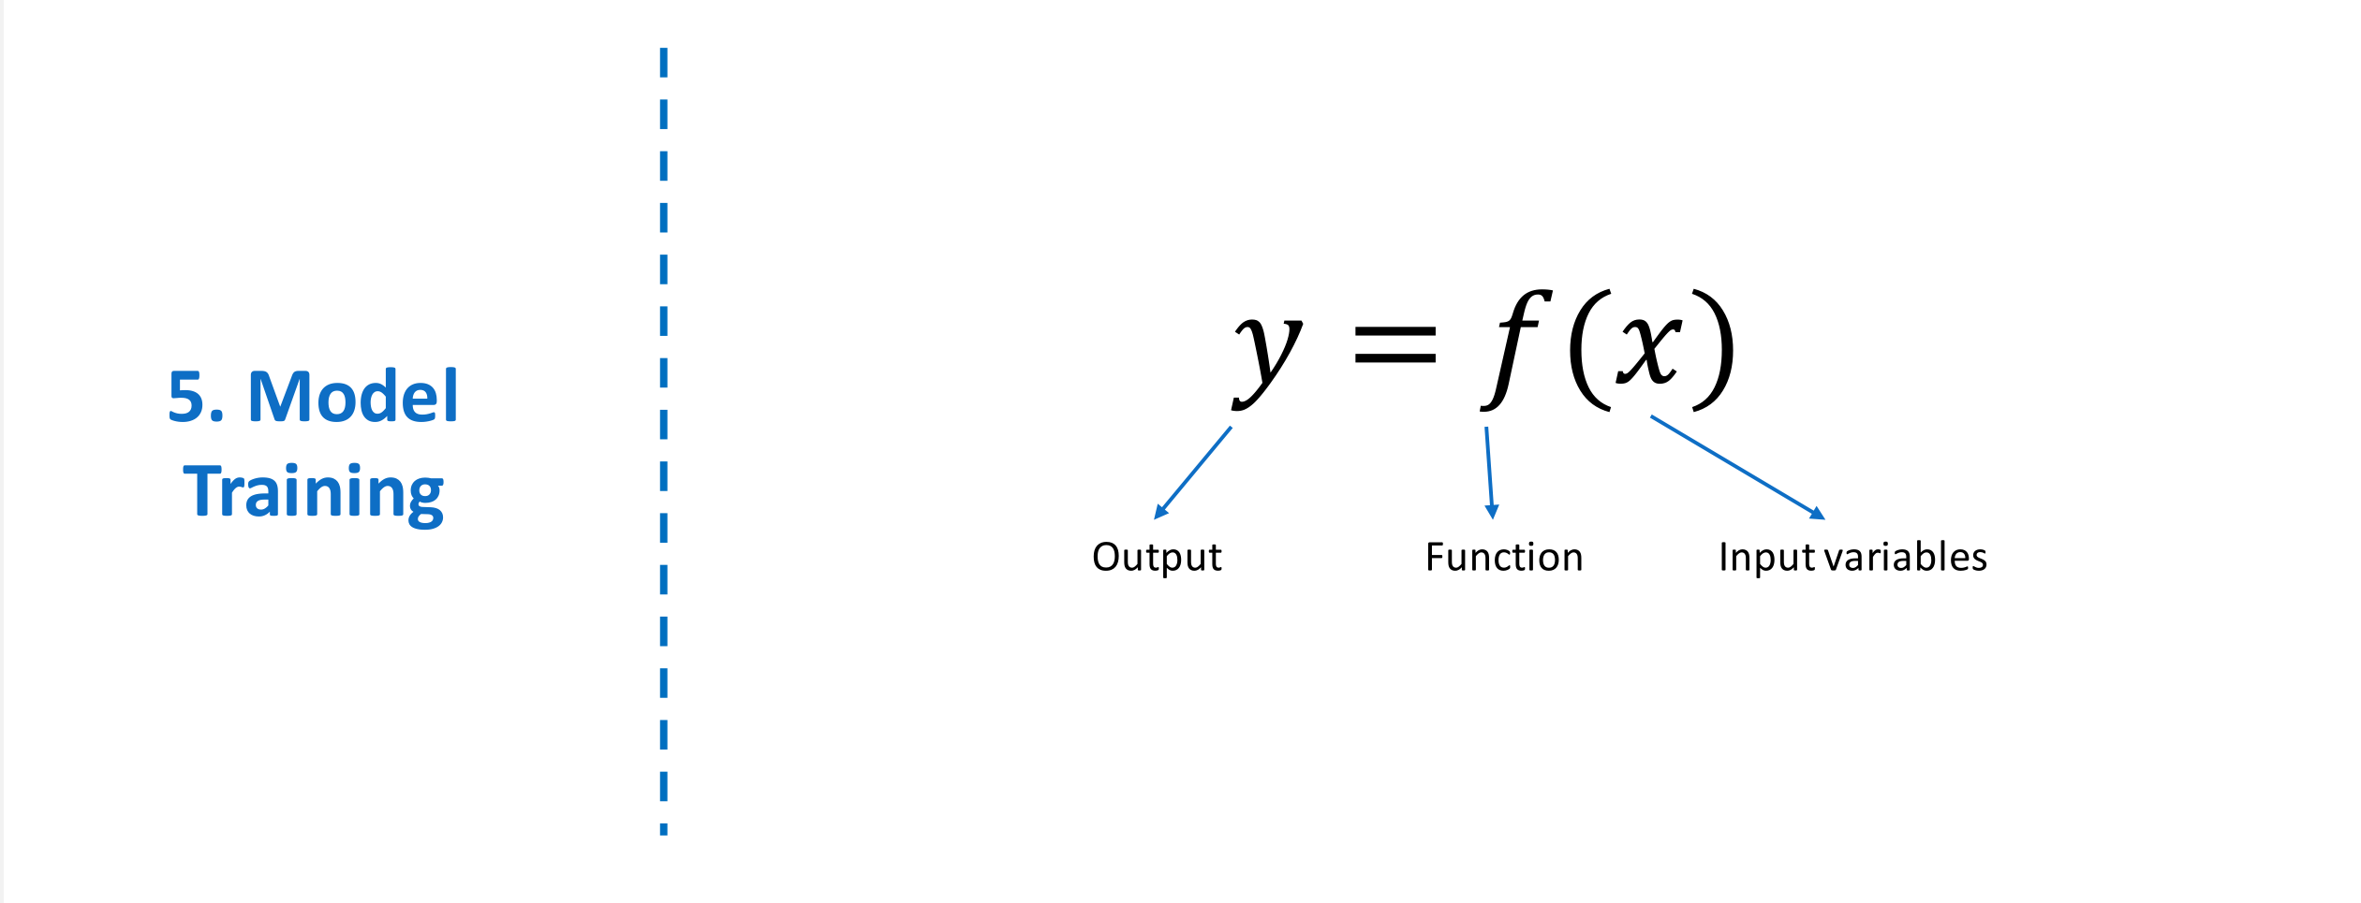
Machine Learning Model

Slide 26
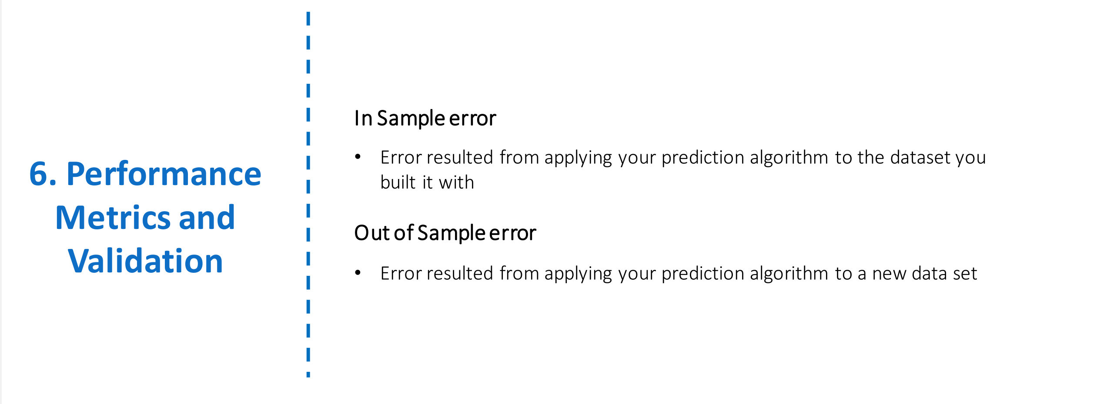
Machine Learning Model

Slide 27
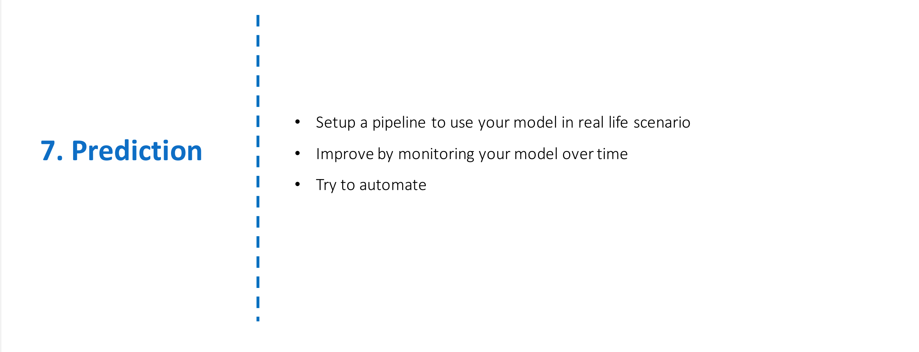
Machine Learning Model

Slide 28
Introduction to forecasting
Customer Acquisition Cost
Sales Forecasting
Customer Lifetime Value
Customer Engagement

Slide 29

Workforce Forecasting
Sales forecasting is the process of estimating future staffing needs
Forecast can help in planning for future
What & Why

Slide 30
Workforce Forecasting
Time series forecast – Find patters in historical data
Customer
What & Why
Machine Learning models – Relationship with other factors
Business growth
Unemployment rate
Industry trends
Workforce

Slide 31

Help John
John
Data Analytics Manager at STA Fast Foods
John, a data analyst at STA Fast Foods, is tasked with predicting sales for a potential new store. He analyzes factors like location, parking space, average income, local competition, and population density to estimate the store’s revenue. His goal is to guide STA in selecting a site that will maximize profits, ensuring the expansion is a success.
Start-Tech Academy

Slide 32
Linear Regression
Find relationship between sales and other factors
Store size
Population density
Location type
What & Why
Salary
If the Store size changes, what happens to sales?

Slide 33
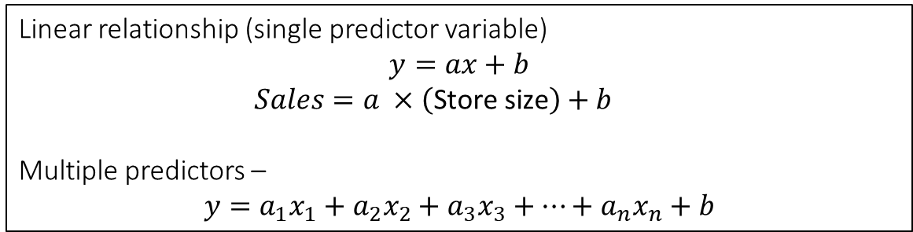
Linear Regression
Store size
Sales
Predictor variables
Target variable
Independent variables
Dependent variable
How
Linear relationship (single predictor variable)
$$y=ax+b$$
$Sales=a ×\left(\text{Store} \text{size}\right)+b$
Multiple predictors –
$$y=a_{1}x_{1}+a_{2}x_{2}+a_{3}x_{3}+…+a_{n}x_{n}+b$$

Slide 34
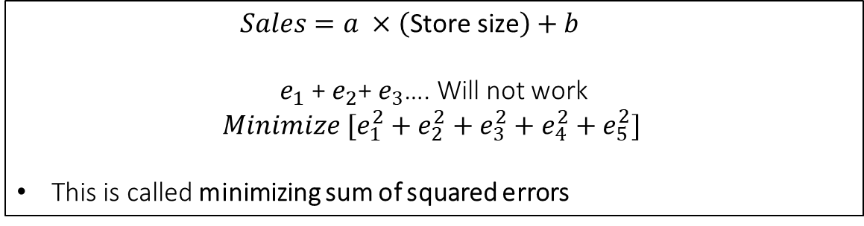
Linear Regression
Sales
$$500$$
$$e_{2}$$
$$e_{4}$$
$$e_{5}$$
$$400$$
$$e_{1}$$
$$e_{3}$$
$$300$$
$$200$$
How
$$100$$
$$200$$
$$400$$
$$150$$
$$350$$
Size
$$100$$
$$300$$
2$50$
$Sales=a ×\left(\text{Store} \text{size}\right)+b$
$e_{1}$ + $e_{2}$+ $e_{3}$…. Will not work
$${Minimize [e}_{1}^{2}+e_{2}^{2}+e_{3}^{2}+e_{4}^{2}+e_{5}^{2}]$$
This is called minimizing sum of squared errors
$$50$$

Slide 35
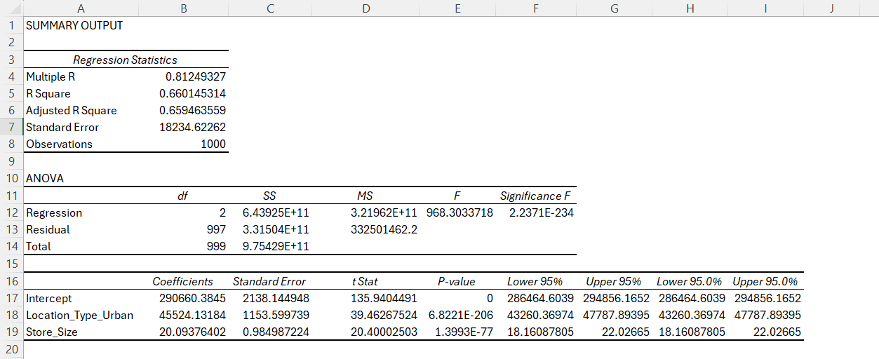
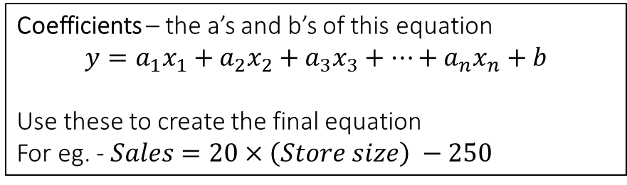
Linear Regression
Significance F – tells if the predictor variables can be used to predict target values. Should be small.
Rule of thumb – significance F should be less than 0.1, for more than 90% confidence
R square – how well our model explains the variations in value of sales
Adjusted R square – if there are more than one predictor variables, use adjusted R Square
Coefficients – the a’s and b’s of this equation
$$y=a_{1}x_{1}+a_{2}x_{2}+a_{3}x_{3}+…+a_{n}x_{n}+b$$
Use these to create the final equation
For eg. - $Sales=20×\left(Store size\right) −250$
P–value – tells if that particular predictor variable has significant relationship with sales
Rule of thumb – p-value should be less than 0.1, for more than 90% confidence
Result

Slide 36
Retention
Extend Customer lifetime by preventing churn
Acquisition cost, Retention efforts, lost revenue etc.
Overall Customer churn rate is the key KPI for Business Growth
What
Time Series forecasting to predict overall churn
ML models to predict probability of churn
Logistic regression can help predict probability of churn
Pitch alternate options/ offers to the customers to retain the customers

Slide 37
Logistic Regression
Uses historical data to train, same as linear regression
Linear Regression – predicts continuous variable
Logistic Regression – predicts categorical variable
What
Output of logistic regression corresponds to probability of belonging to one of the categories

Slide 38
Logistic Regression
Annual Income | Satisfaction score | Avg Transaction (Per Month) | Churned?
140 | 2 | 34 | 1
150 | 4 | 60 | 0
220 | 4 | 100 | 0
… | … | … | …
Example
Use this data to train our logistic regression model
Annual Income | Satisfaction score | Avg Transaction (Per Month) | Churned?
200 | 2 | 20 | 0.75
150 | 4 | 80 | 0.32

Slide 39
Logistic Regression
 | Predicted Positive | Predicted Negative
Actual Positive | True Positive | False Negative
Actual Negative | False Positive | True Negative
True Positive - the model correctly predicted the churn.
False Positive - the model incorrectly predicted the churn.
True Negative - the model correctly predicted the retention.
False Negative - the model incorrectly predicted the retention.
Confusion Matrix
Accuracy = (True positive + True Negative)/ Total cases
 | Predicted Positive | Predicted Negative
Actual Positive | 63 | 27
Actual Negative | 38 | 122
Accuracy = (63+122)/250 = 185/250 = 74 %

Slide 40

Help Tim
Tim
Customer Analytics Manager at STA superstore
STA Superstore is a supermarket that serves a large customer base and has extensive data on its customers' shopping habits.
Tim has been tasked with reducing customer churn. He believes that by using a logistic regression model, he can predict which customers are likely to stop shopping at the store. After identifying these at-risk customers, Tim thinks TA Superstore can improve retention by addressing their preferences and offering targeted discounts.
Start-Tech Academy

Slide 41
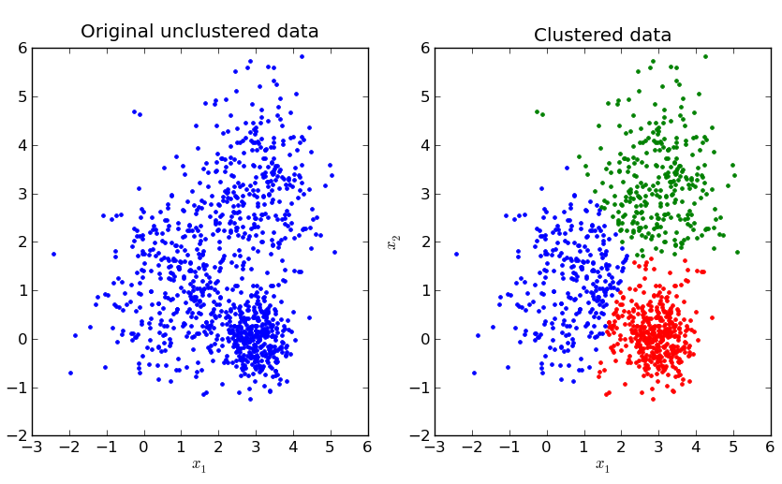
Introduction to Clustering
Definition: Clustering is a technique used in data analytics to group objects in such a way that objects in the same group (or cluster) are more similar to each other than to those in other groups.
Unsupervised Learning: Unlike forecasting, regression, and classification, clustering is an unsupervised learning method, meaning it does not rely on predefined labels or outcomes. Instead, it discovers the natural groupings within the data.

Slide 42
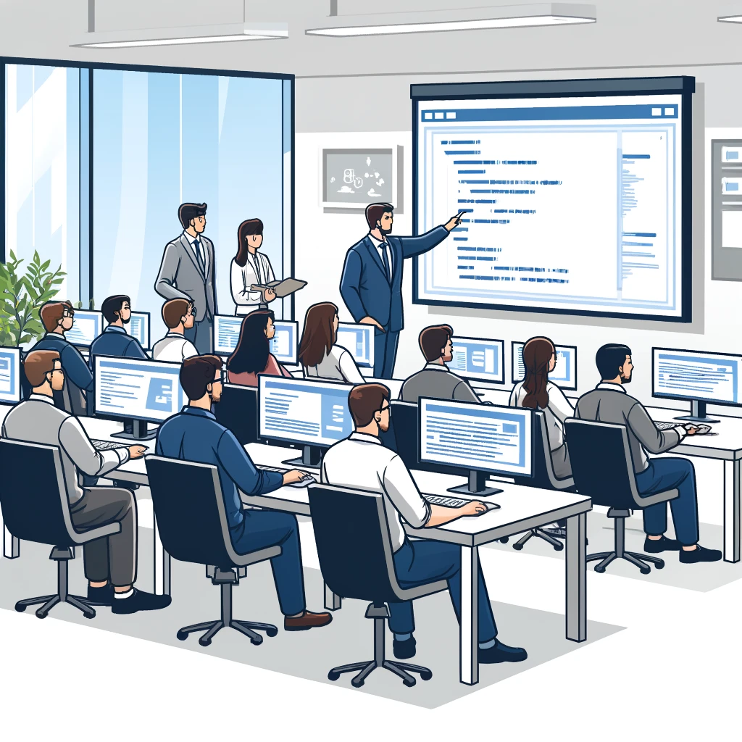
Introduction to Clustering
Scenario: Imagine you are a store manager tasked with dividing a group of 300 customers into three distinct groups for targeted marketing and engagement strategies.
Data Collection: Each of the 300 customers has been assessed on three criteria: purchase frequency, average transaction value, and product preferences. The scores range from 1 to 10 for each criterion.

Slide 43

Example
Cluster Analysis:
Cluster 1: Customers with high purchase frequency but lower average transaction value and limited product preferences.
Cluster 2: Customers with moderate scores across all three criteria: purchase frequency, average transaction value, and product preferences.
Cluster 3: Customers with high average transaction value and diverse product preferences but lower purchase frequency.

Slide 44
K Mean Clustering
Suppose point represents purchase frequency
12 Customers
Create 3 groups
0
10
Start-Tech Academy

Slide 45
K Mean Clustering
Randomly choose 3 points (centroids)
Start-Tech Academy

Slide 46
K Mean Clustering
Measure distance of a point with 3 centroids
Start-Tech Academy

Slide 47
K Mean Clustering
Measure distance of a point with 3 centroids
Start-Tech Academy

Slide 48
K Mean Clustering
Measure distance of a point with 3 centroids
Start-Tech Academy

Slide 49
K Mean Clustering
Measure distance of a point with 3 centroids
Start-Tech Academy

Slide 50
K Mean Clustering
Measure distance of a point with 3 centroids
Start-Tech Academy

Slide 51
K Mean Clustering
Measure distance of a point with 3 centroids
Start-Tech Academy

Slide 52
K Mean Clustering
Measure distance of a point with 3 centroids
Start-Tech Academy

Slide 53
K Mean Clustering
End of 1st cycle
Start-Tech Academy

Slide 54
K Mean Clustering
Take the average of each cluster and shift the centroid to that point
Start-Tech Academy

Slide 55
K Mean Clustering
Measure distance of a point with 3 new centroids and reassign
Start-Tech Academy

Slide 56
K Mean Clustering
Measure distance of a point with 3 new centroids and reassign
Start-Tech Academy

Slide 57
K Mean Clustering
Measure distance of a point with 3 new centroids and reassign
Start-Tech Academy

Slide 58
K Mean Clustering
End of cycle 2
Now again, take the average of each cluster and shift the centroid to that point
Start-Tech Academy

Slide 59
K Mean Clustering
Now again, take the average of each cluster and shift the centroid to that point
Start-Tech Academy

Slide 60
K Mean Clustering
Reassign points
Start-Tech Academy

Slide 61
K Mean Clustering
End of cycle 3. Now again, take the average of each cluster and shift the centroid to that point
Start-Tech Academy

Slide 62
K Mean Clustering
Measure distance of a point with 3 new centroids and reassign
Start-Tech Academy

Slide 63
K Mean Clustering
If no changes, STOP
Cluster 1
Cluster 2
Cluster 3
Start-Tech Academy

Slide 64
K Mean Clustering
Randomness may result in different results
Start-Tech Academy

Slide 65

Help Jim
Jim
Customer Analytics Manager at STA Star Mall
Jim has been tasked with designing effective marketing strategies for customers at STA Mall. He believes that he can use a K-means clustering model to group customers based on their spending score and annual income. After identifying these groups, he thinks that STA Mall can enhance sales results by tailoring advertisements and discounts to meet the specific needs of each customer segment, ultimately improving customer satisfaction and driving sales.
Start-Tech Academy

